Slide 1
CAPSTONE EDA PROJECT TOPIC -II
HOTEL_BOOKINGS_ANALYSIS
Team Members:
Rishikesh Damale
Shubham Kishorrao Joshi
Kanika Kakra
Akshay Fasale

Slide 2
ACKNOWLEDGEMENT
We would express our gratitude towards the entire team of “Almabetter” for acknowledging us with such important domain and providing us an opportunity to work on real life problems through Capstone Project.

Slide 3
Data Analytics and its importance
Data analytics (DA) is the process of examining data sets in order to find trends and draw conclusions about the information they contain.
Data analytics initiatives can help businesses increase revenue, improve operational efficiency, optimize marketing campaigns and bolster customer service efforts.
Analytics also enable organizations to respond quickly to emerging market trends and gain a competitive edge over business rivals.
The ultimate goal of data analytics, however, is boosting business performance.

Slide 4
Steps followed :-
Importing necessary packages and libraries.
Mount the drive in colab and read the .csv file.
Analysing the data sheet.
Removing null/NAN/duplicate rows.
Fixing the outliers.
Drop certain columns/combined certain columns to make our data sheet free Avoid of any irrelevant data.
Applying the concept of Data Wrangling and Data Visualization such that we can analyse the data sheet and retrieve required information.

Slide 5
Problem Statement
Have you ever wondered when the best time of year to book a hotel room is? Or the optimal length of stay in order to get the best daily rate? This hotel booking dataset can help you explore those questions!
This data set contains booking information for a city hotel and a resort hotel, and includes information such as when the booking was made, length of stay, the number of adults, children, and/or babies, and the number of available parking spaces, among other things. All personally identifying information has been removed from the data.
Explore and analyze the data to discover important factors that govern the bookings.

Slide 6
Description of columns
Column_name | Column_description
Hotel | Contain data values hotel City ,Resort
is_canceled | Contains boolean data values 0-->not_canceled 1-->canceled
lead_time | Number of days between the entering date of booking and arrival date
arrival_date_year | Year of the arrival date of guests
arrival_date_month | Month of the arrival date of guests
arrival_date_week_number | Week number of year of arrival date
arrival_date_day_of_month | Day of the arrival of guests

Slide 7
distribution_channel | Bookings distribution
is_repeated_guest | Having values 1🡪repeated guests 0->no repeated guests
previous_cancellations | Number of previous bookings that were cancelled by the guests prior to the current booking
Previous_booking_not_cancellations | Number of previous bookings that were not cancelled by the guests prior to the current booking
reserved_room_type | Room type --- reserved
booking_changes | Number of changes made to the booking from the moment the booking was entered on the pms until the moment of check-in or cancellation
deposit_type | Categorical values—No deposit , Refund, Non-refund
agent | ID of the travel agency made the booking

Slide 8
Stays_in_weekend_nights | Number of days for stay on weekend night
Stays_in_week_nights | Number of days for stay on week day
adults | Number of adults
children | Number of children
babies | Number of babies
meal | Type of meal offered
country | Countries from where guests arrived
market_segment | Categorical values like TA🡪Travel agent TO-> Tour Operators

Slide 9
days_in_waiting_list | Number of days the booking was in the waiting list before it was confirmed
customer_type | Categorical values🡪 contract group, transient, party
Average_daily_rate | Obtained by dividing the sum of all lodging transaction by the total number of staying nights
required_car_parking_spaces | Number of car parking spaces used by guests
total_of_special_requests | Number of special requests made by guests(eg-extra bedsheet)
reservation_status | Contains the current status
total_members | Number of adults + Number of children + Number of babies

Slide 10
Full_stay | Number of stays_in_weekend_nights + Number of stays_in_week_nights

Slide 11
Analysis & Observations
Here we present some of the basic as well as some advanced observations retrieved from the data sheet.

Slide 12
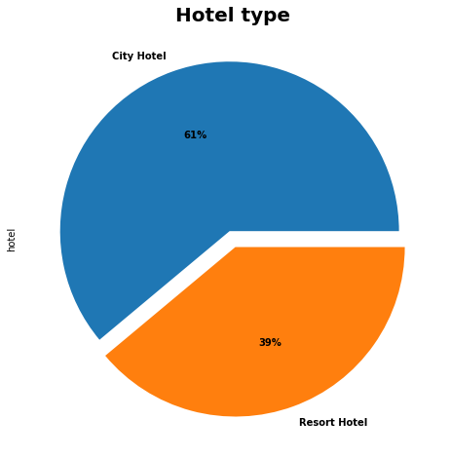
Hotel type Percentage
We observed City Hotel shares 61% out of 100 than Resort Hotel.

Slide 13
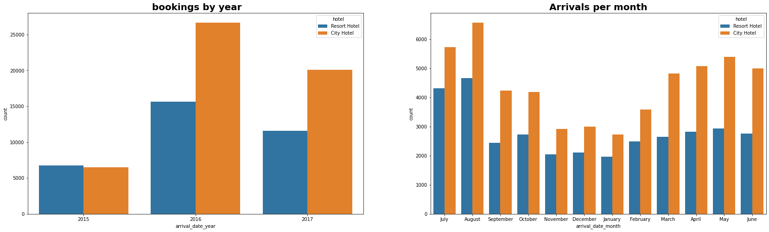
Hotel Wise Bookings based on Month and Year
Bookings for City hotels are higher than Resort hotels over the years and in year 2016 the bookings for both the hotels were maximum.
Most bookings were done in the month of May,June, July, August.

Slide 14
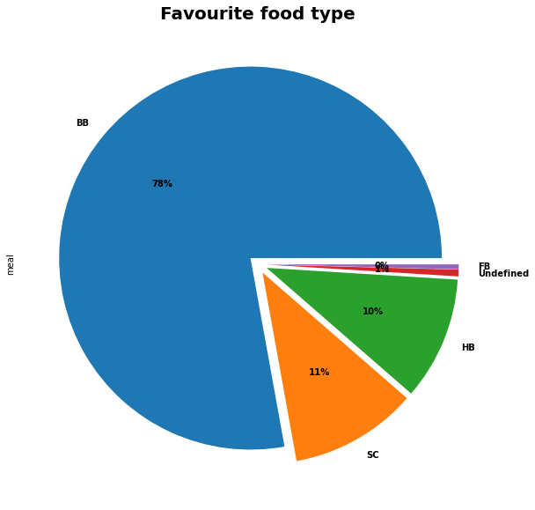
Favourite meal by hotel type
The most prefered meal type is BB
BB - Bed and breakfast
HB - Half board meal
FB - Full board meal
SC - Self catering

Slide 15
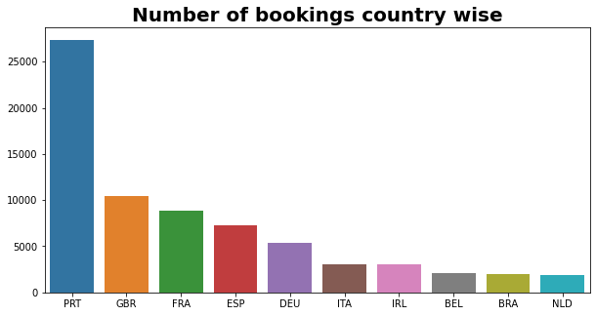
From which country guests are visiting the hotel?
The most guests visited the hotels are from Portugal and other European countries.

Slide 16
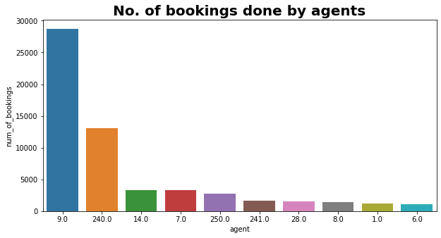
Which agent made the maximum bookings?
Most no. of bookings is done by agent number 9.

Slide 17
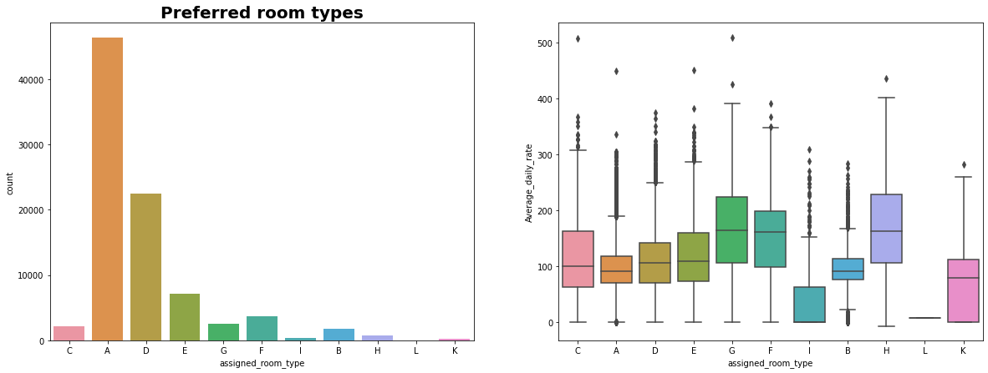
Preferred Room Type
Most preferred room is type ‘A’ But rooms with better 'Average daily rate' are of type H,G,F and C.

Slide 18
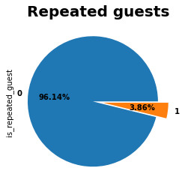
Percentage of guests visiting the hotel repeatedly
Hotels have only 4% repeated guests.
The guests retention rate is low.

Slide 19
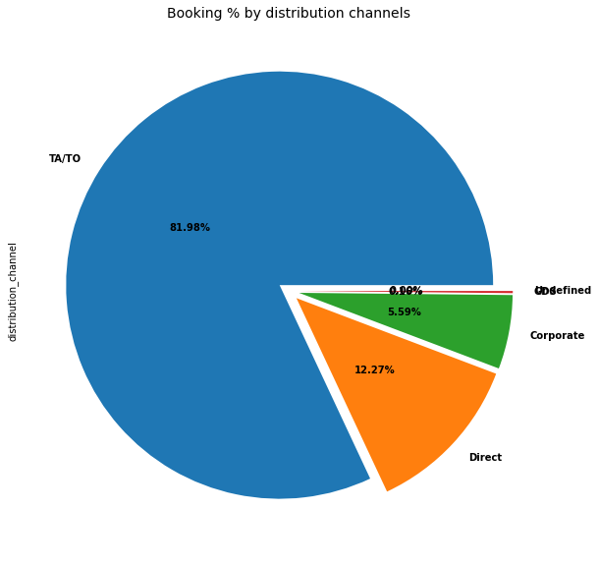
Distribution Channel Type
Nearly 82% of share of Distribution channel is occupied by TA/TO

Slide 20
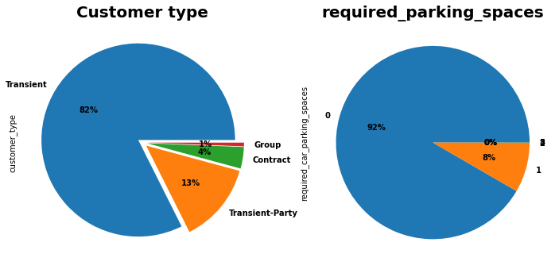
Customer type and car parking details
There are 4 types of Customer. Only 8% people require parking Out of them most are of 'Transient Type“ spaces.

Slide 21
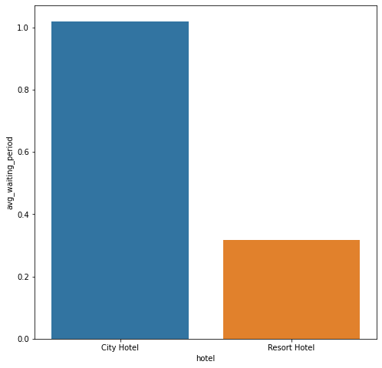
Waiting Time
City hotel has significantly longer waiting time, hence City Hotel is much busier than Resort Hotel.

Slide 22
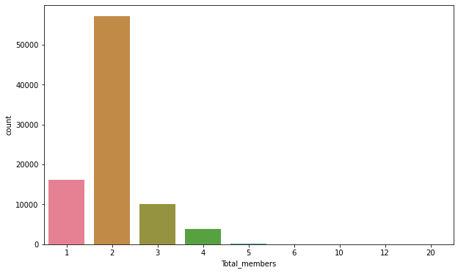
Total no. of peoples per booking.
Most guests prefer to come as pair of 2 Adults.

Slide 23
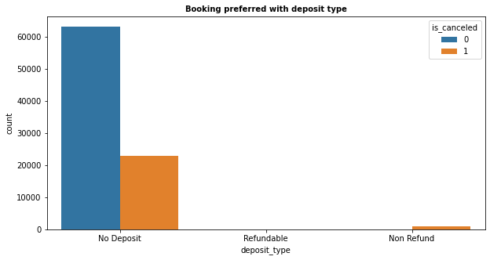
Bookings preferred with deposit type
As expected , Most Bookings are done with 'No deposit' and most cancellations are also in 'no deposit' bookings. It is a surprise to see cancellations with 'Non-refundable' bookings

Slide 24
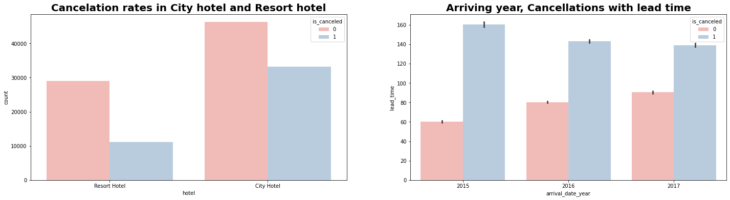
Cancellation rates in hotel and year-wise analysis
The rate of cancellation is higher in City hotel. In year 2015 rate of cancellation was low.

Slide 25
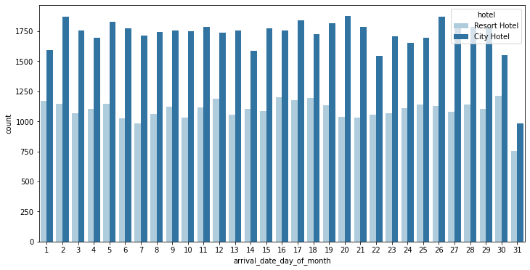
Day-wise analysis of guests arrival
We observed everyday the guest arrival is more in city hotel .

Slide 26
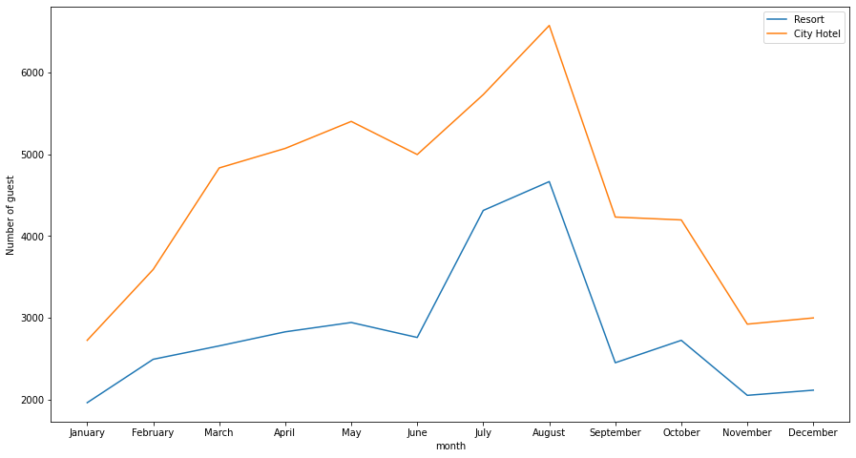
Figuring out the busiest months of the year
We observed that the busiest months for both the hotels are May, June , July and August.

Slide 27
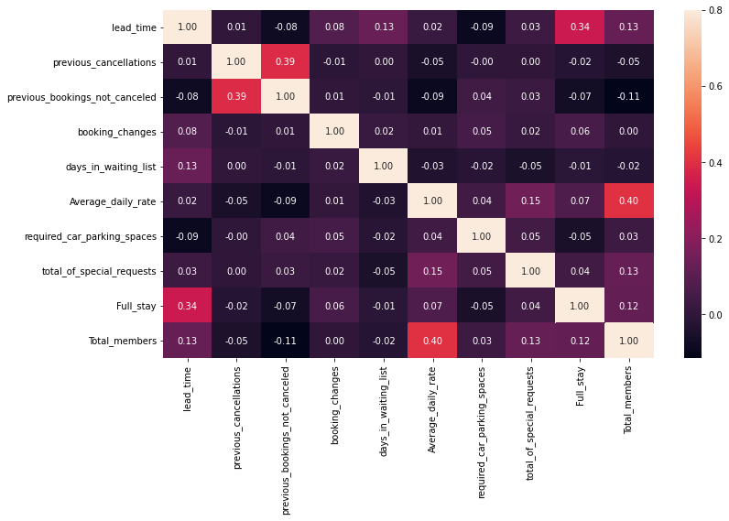
Analysing the correlation
Full_stay length and lead time have slight correlation. This may means that for longer hotel stays people generally plan little before the the actual arrival.
Average_daily_rate is slightly correlated with Total_members, which makes sense as more no. of people means more revenue, therefore more Average_daily_rate.

Slide 28
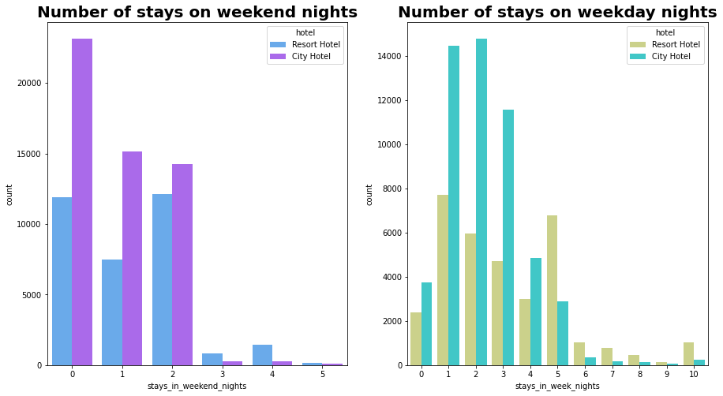
Bookings on weekends and weekdays
City hotels have more number of stays irrespective of week or weekend stays than resort hotel

Slide 29
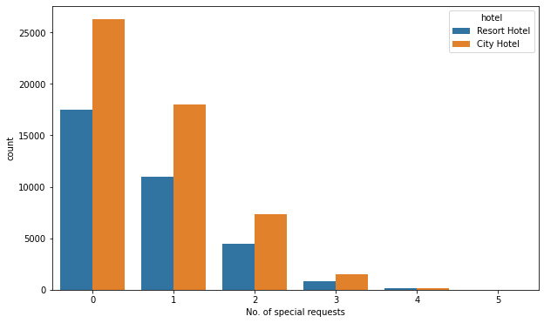
16.Special requests service offered by hotels
We observed City hotels have more no. of special requests. Most of them ask for only 1 special request.

Slide 30
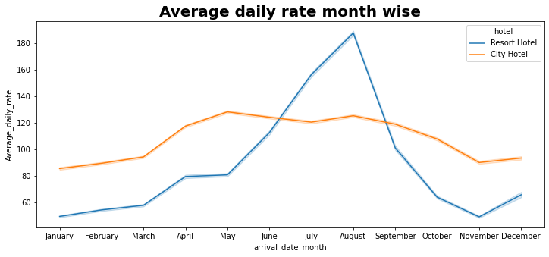
Average_daily_rate month-wise
For resort hotels, the average daily rate is more expensive during July, August and September.
For city hotels, the average daily rate is more expensive during May, June, July and August.

Slide 31
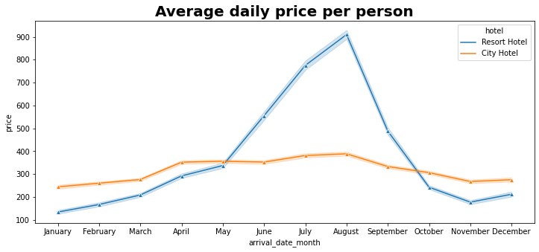
Average_daily_price per person
Prices of resort hotel are much higher.
Prices of city hotel do not fluctuate that much.

Slide 32
Conclusion
More than 61% of the population booked the city hotel for their stay.
Out of three years 2016 is the busiest for hotels.
Most no of the bookings are made in the middle part of the year(specifically, July and August)
decreasing toward the start and end of the year.
The majority of guests come from western europe countries with Portugal being the leader.
Given that we only have 4% repeated guests.
Hotels should target their advertisement and services on guests to increase returning rate.

Slide 33
Most common stay length is less than or equal to 4 days and generally people prefer City hotel for short stay, but for longer stays, Resort Hotel is preferred.
Couple(or 2 adults) is the most popular accommodation type. So hotels can make arrangement plan accordingly.
80% distribution_channel is of TA/TO.
For customers, generally the longer stays (more than 15 days) can result in better deals in terms of low average daily rate.

Slide 34
THANK YOU

